Slide 1

Chapter 15 (continued)
External Methods
© 2011 Pearson Addison-Wesley. All rights reserved
15 B-<number>

Slide 2
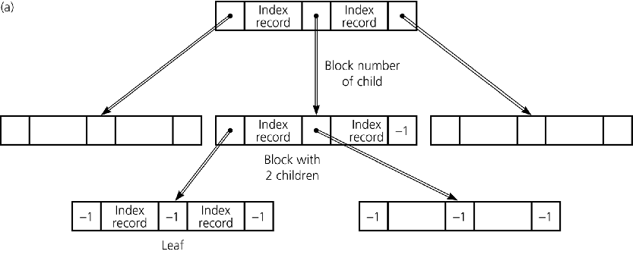
B-Trees
To organize the index file as an external search tree
  Use block numbers for child pointers
    A child pointer value of –1 is used as the null pointer
Figure 15-10a
a) Blocks organized into a 2-3 tree
© 2011 Pearson Addison-Wesley. All rights reserved
15 B-<number>

Slide 3
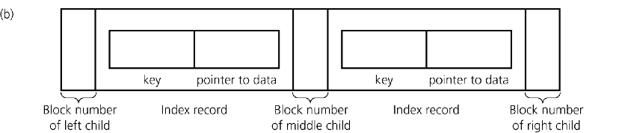
B-Trees
If the index file is organized into a 2-3 tree
  Each node would contain
    Either one or two index records, each of the form
    <key, pointer>
    Three child pointers
Figure 15-10b
b) a single node of the 2-3 tree
© 2011 Pearson Addison-Wesley. All rights reserved
15 B-<number>

Slide 4
B-Trees
An external 2-3 tree is adequate, but an improvement is possible
To improve efficiency
  Allow each node to have as many children as possible
    In an external environment, the advantage of keeping a search tree short far outweighs the disadvantage of performing extra work at each node
    Block size should be the only limiting factor for the number of children
© 2011 Pearson Addison-Wesley. All rights reserved
15 B-<number>

Slide 5
B-Trees
Binary search tree
  If a node N has two children, it must contain one key value
2-3 tree
  If a node N has three children, it must contain two key values
General search tree
  If a node N has m children, it must contain m – 1 key values
© 2011 Pearson Addison-Wesley. All rights reserved
15 B-<number>

Slide 6
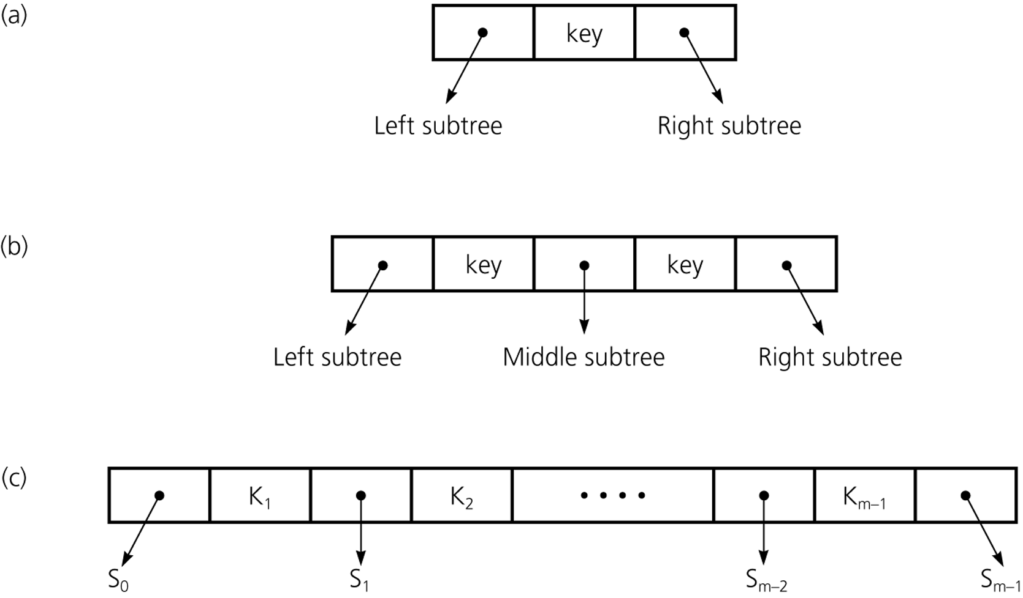
B-Trees
Figure 15-11
a) A node with two children; b) a node with three children; c) a node with m children
© 2011 Pearson Addison-Wesley. All rights reserved
15 B-<number>

Slide 7
B-Trees
B-tree of degree m
  All leaves are at the same level
  Nodes
    Each node contains between m – 1 and [m/2] records
    Each internal node has one more child than it has records
    Exception: The root can contain as few as one record and can have as few as two children
  Example
    A 2-3 tree is a B-tree of degree 3
© 2011 Pearson Addison-Wesley. All rights reserved
15 B-<number>

Slide 8
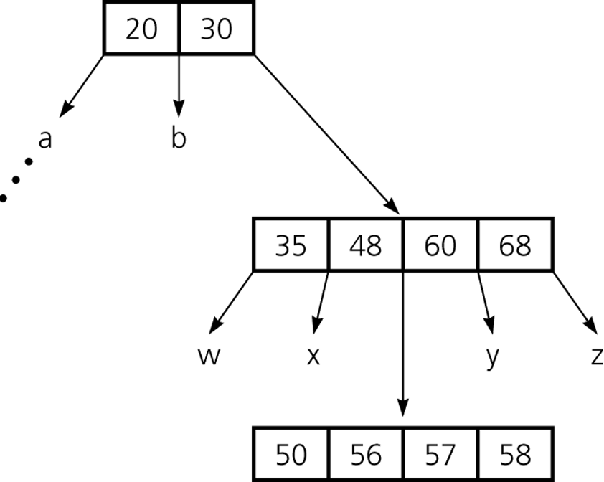
B-Trees
Figure 15-13
A B-tree of degree 5
© 2011 Pearson Addison-Wesley. All rights reserved
15 B-<number>

Slide 9
B-Trees
Insertion into a B-tree
  Step 1: Insert the data record into the data file
  Step 2: Insert a corresponding index record into the index file
© 2011 Pearson Addison-Wesley. All rights reserved
15 B-<number>

Slide 10
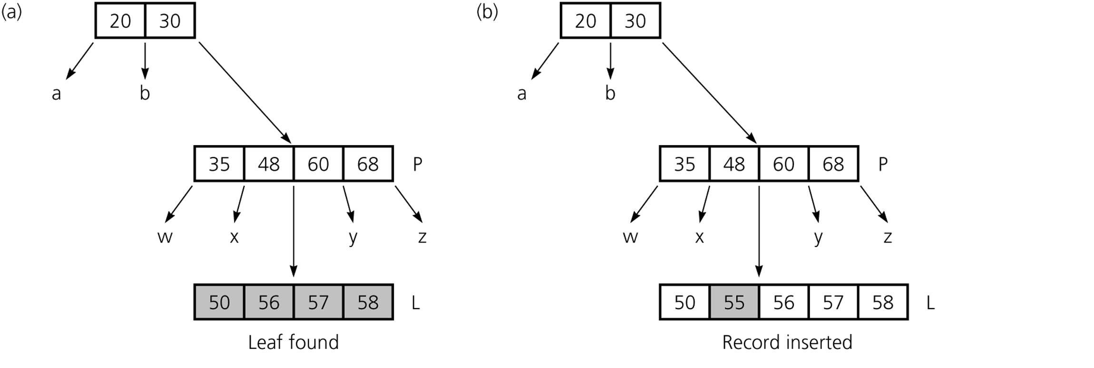
B-Trees
Figure 15-14a and b
The steps for inserting 55
© 2011 Pearson Addison-Wesley. All rights reserved
15 B-<number>

Slide 11
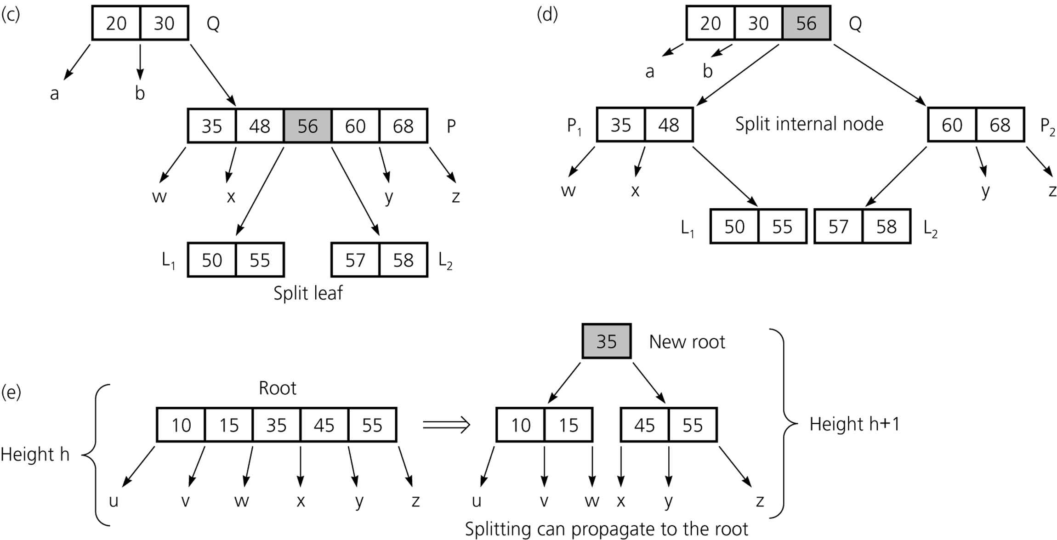
B-Trees
Figure 15-14c-e
The steps for inserting 55
© 2011 Pearson Addison-Wesley. All rights reserved
15 B-<number>

Slide 12
B-Trees
Deletion from a B-tree
  Step 1: Locate the index record in the index file
  Step 2: Delete the data record from the data file
© 2011 Pearson Addison-Wesley. All rights reserved
15 B-<number>

Slide 13
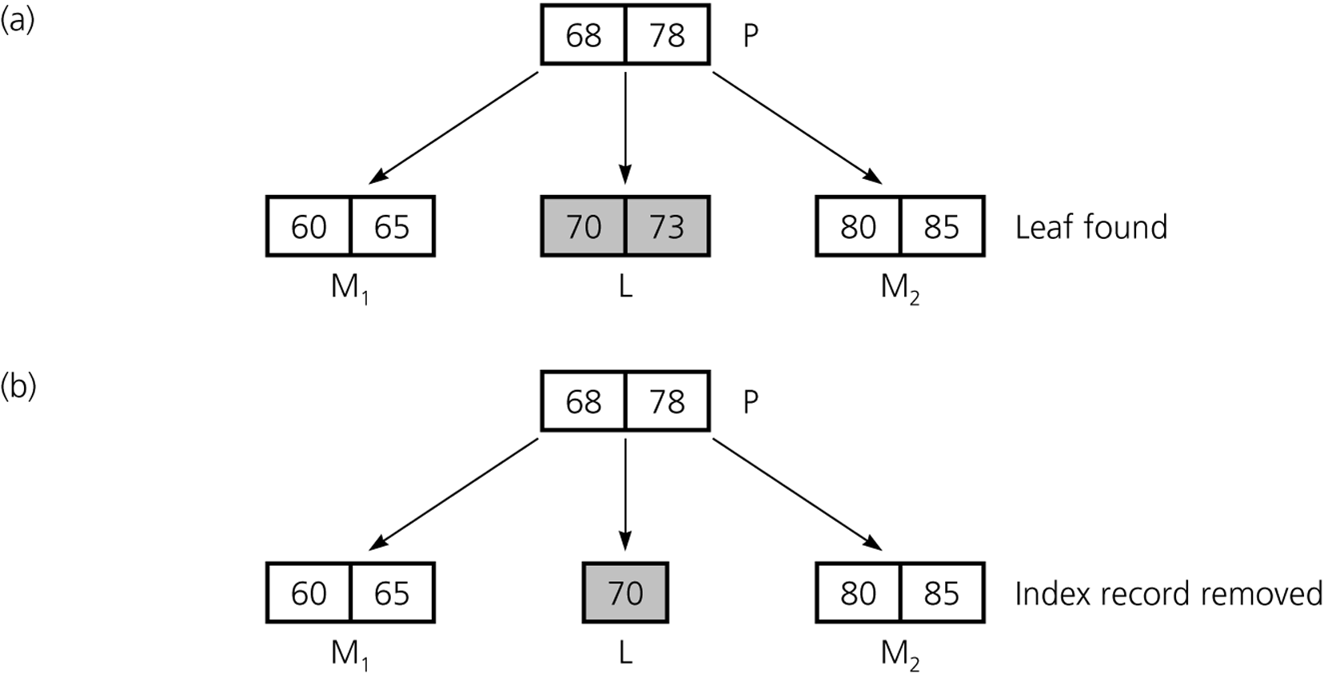
B-Trees
Figure 15-15a and b
The steps for deleting 73
© 2011 Pearson Addison-Wesley. All rights reserved
15 B-<number>

Slide 14
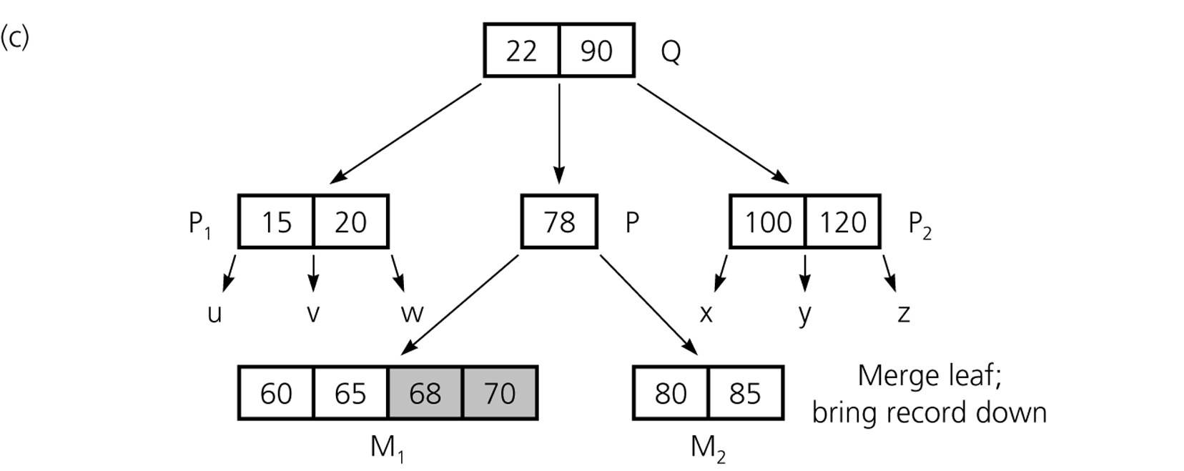
B-Trees
Figure 15-15c
The steps for deleting 73
© 2011 Pearson Addison-Wesley. All rights reserved
15 B-<number>

Slide 15
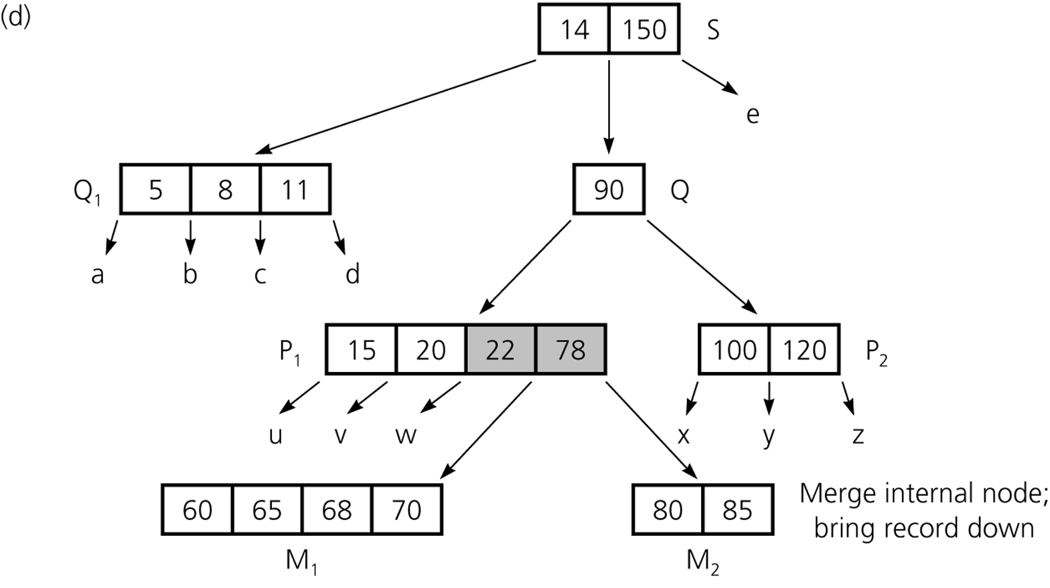
B-Trees
Figure 15-15d
The steps for deleting 73
© 2011 Pearson Addison-Wesley. All rights reserved
15 B-<number>

Slide 16
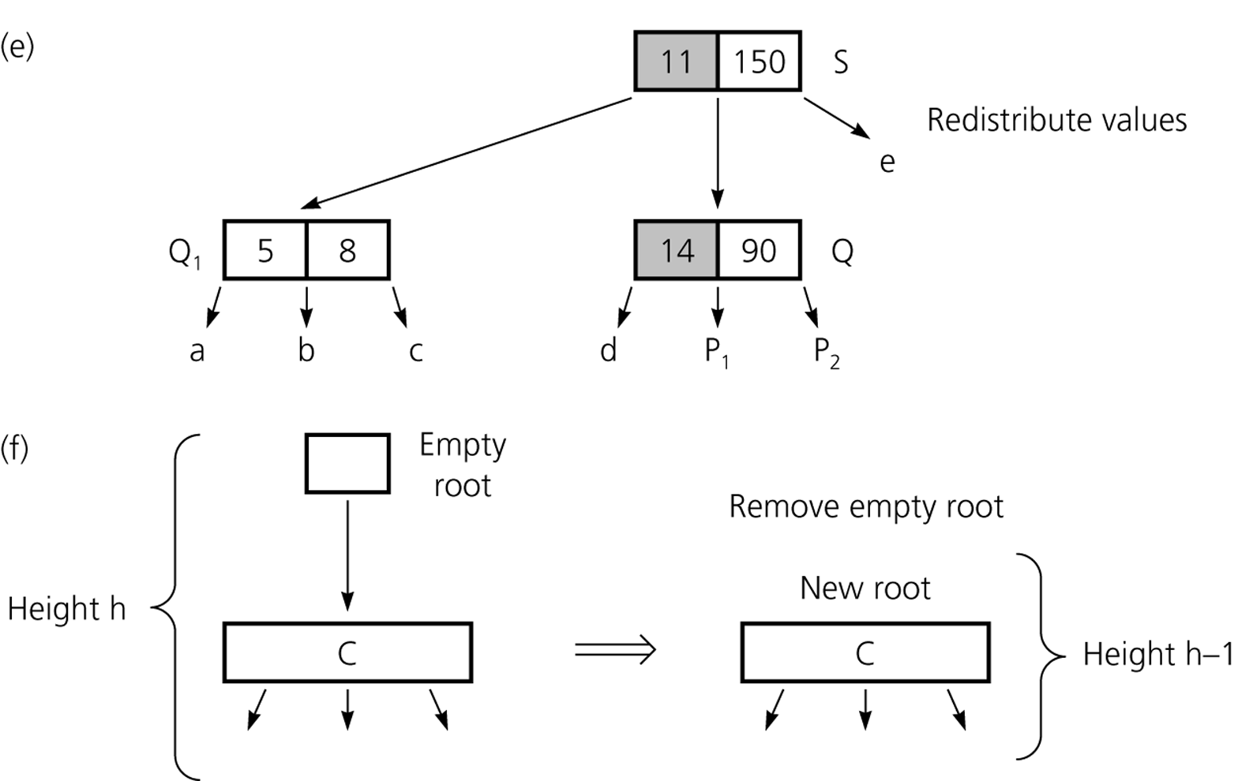
B-Trees
Figure 15-15e and f
The steps for deleting 73
© 2011 Pearson Addison-Wesley. All rights reserved
15 B-<number>

Slide 17
Traversals
Accessing only the search key of each record, not the data file
  Not efficiently supported by the hashing implementation
  Efficiently supported by the B-tree implementation
    The search keys can be visited in sorted order by using an inorder traversal of the B-tree
Accessing the entire data record
  Not efficiently supported by the B-tree implementation
© 2011 Pearson Addison-Wesley. All rights reserved
15 B-<number>

Slide 18
Multiple Indexing
Advantage
  Allows multiple data organizations
Disadvantage
  More storage space
  Additional overhead for updating each index whenever the data file is modified
© 2011 Pearson Addison-Wesley. All rights reserved
15 B-<number>

Slide 19
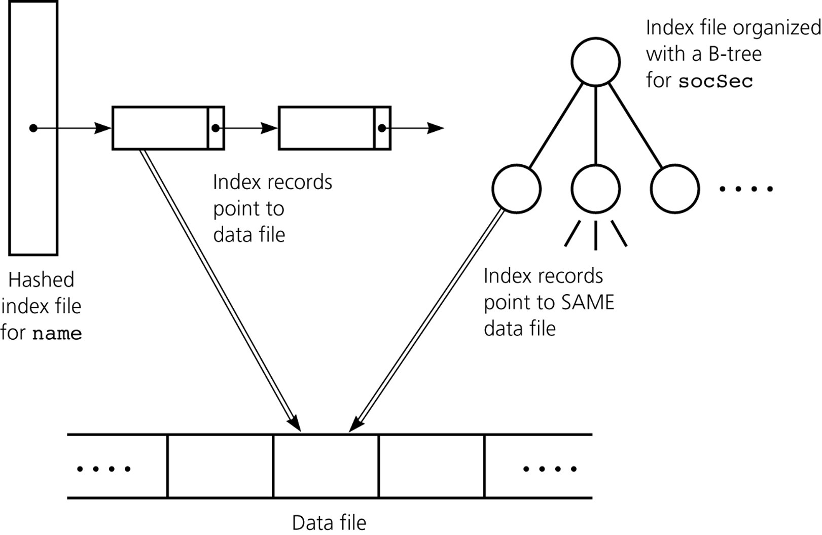
Multiple Indexing
Figure 15-16
Multiple index files
© 2011 Pearson Addison-Wesley. All rights reserved
15 B-<number>

Slide 20
Summary
An external file is partitioned into blocks
  Each block typically contains many data records
  A block is generally the smallest unit of transfer between internal and external memory
In a random access file, the i^{th} block can be accessed without accessing the blocks that precede it
A modified mergesort algorithm can be used to sort an external file of records
© 2011 Pearson Addison-Wesley. All rights reserved
15 B-<number>

Slide 21
Summary
An index to a data file is a file that contains an index record for each record in the data file
The index file can be organized using either hashing or a B-tree
  These schemes allow you to perform the basic table operations by using only a few block accesses
Several index files can be used with the same data file to perform different types of operations efficiently
© 2011 Pearson Addison-Wesley. All rights reserved
15 B-<number>

